Slide 1
Big Mountain Ski Resort
Ticket Price Prediction Model

Slide 2
Problem Identification
Purpose:
Estimate the market value ticket price of Big Mountain Ski Resort based on the ticket values and facilities of competitor resorts.
Assumptions
Competitor resort pricing is based on the free market
Ticket pricing is dependent on included resort facilities

Slide 3
Data Wrangling
Data provided by the client originally consisted of categorical data for 330 resorts
Examined for missing values and outliers which may impact or skew the results of the model.
Several items were either updated or removed from the dataset:

Slide 4
Data Wrangling
Data provided by the client originally consisted of categorical data for 330 resorts
Examined for missing values and outliers which may impact or skew the results of the model.
Several items were either updated or removed from the dataset:
The number of resorts remaining in the dataframe is 277
Missing Data
1
Missing Ticket Prices
16% of resorts were missing ticket price data
14% of resorts were missing both weekend and weekday pricing
2% of the resorts were missing either weekend or weekday pricing
Resorts missing both weekend and weekday pricing were removed from the anlaysis
Outlier
Data
2
Skiable Terrain (Silverton Mountain)
Reported Skiable Terrain of 26,816 areas
Significantly larger than competitor resorts
Futher Invetigation revealed an error transposing the data and the area was corrected to 1819, per the companies website.
3
Years of Operation (Howelsen Hill)
Report to be open for 2019 years
The data was published in 2019, therefore this was likely the year the resort opened.
The resort may not have been open at the time the data was collected. Therefore, resort was removed from the analysis

Slide 5
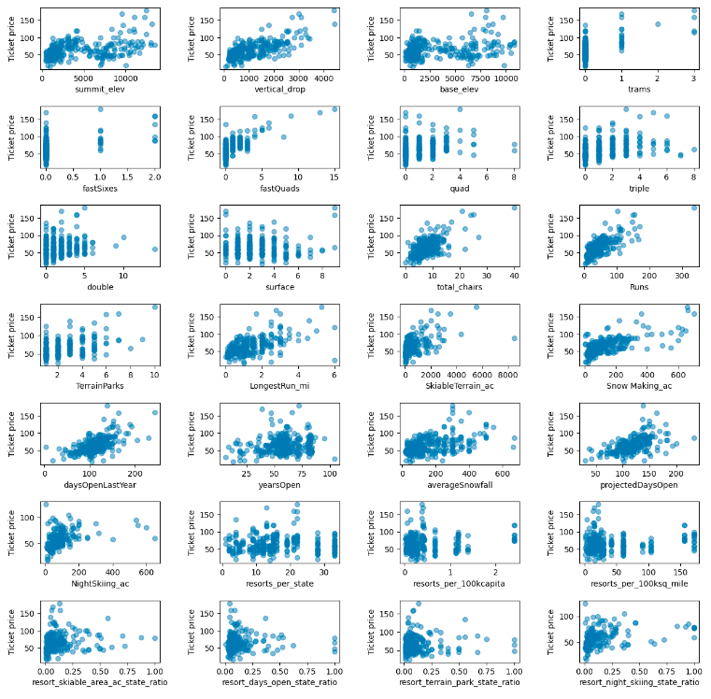
Explority Analysis
Principle components analysis (PCA)
Identify linear combinations of uncorrelated features and their variance
Develop a series of scatterplots to display the relationships between ticket price and remaining variables.
The results show a strong positive relationship between the ticket price and
Vertical drop
FastQuads
Runs
Total chairs

Slide 6
Explority Analysis
Principle components analysis (PCA)
Identify linear combinations of uncorrelated features and variance.
Develop a series of scatterplots to display the relationships between ticket price and remaining variables.
Additionally, the resorts per 100k capita plot shows:
Ticket price is variable when the number of resorts per capita is low
However, ticket prices increase as the number of resorts per capita increase.

Slide 7
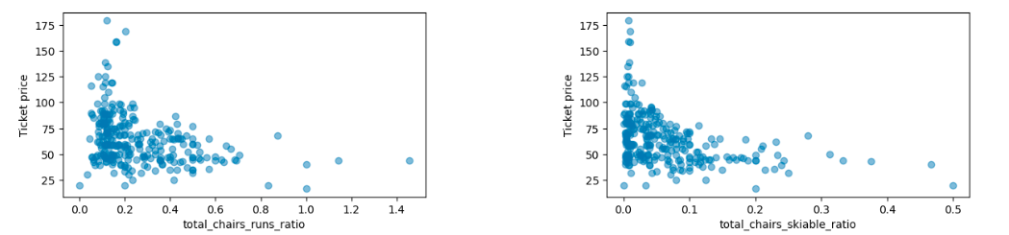
Explority Analysis
Additional plots were developed to determine how transportation may impact the ticket prices at resorts.
Comparing ticket prices to the ratio of chairs:runs and chairs:skiable terrain
The results show:
Negative correlation
May indicate an increase in skiers on the mountain may decrease the prices.

Slide 8
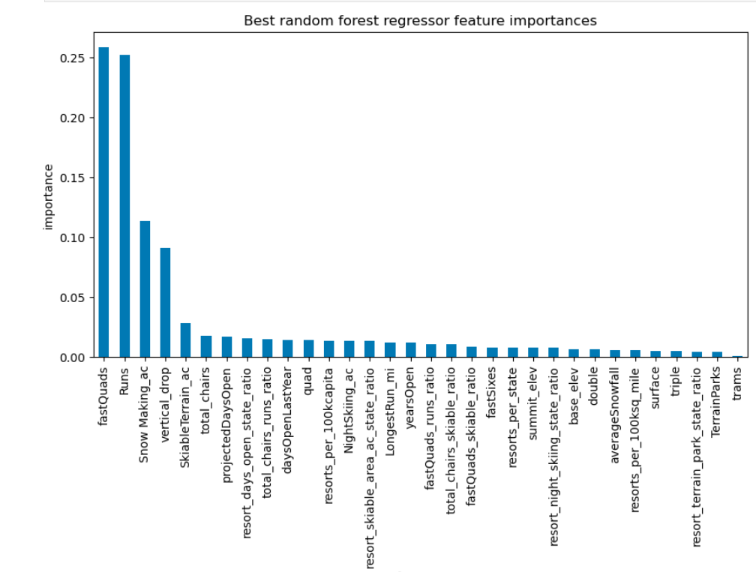
Preprocessing and Training
Random Forest Regression Model
Machine learning predictive model
Combines independent predictions through a weighted average to reduce overfitting and improve accuracy.
The model was trained by partitioning the original data into numerous combinations of the dataset,
Training subset - 70% of the database
Validation subset - 30% of the data
Best fit of weighted data was selected to develop the predictive model

Slide 9
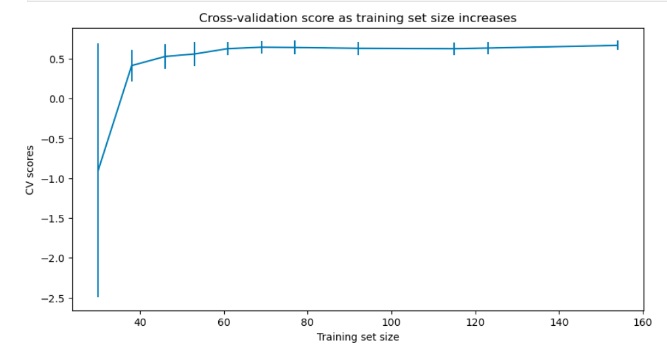
Preprocessing and Training
The cross-validation score, or performance ranking of the model, was determined
The model rapidly improves as more data points are added, then levels off at a sample size of approximately 50.
Therefore, additional data collection is not required to improve the model results.

Slide 10
Summary and Conclusion
Predictive Model Results
The fair market price of an adult weekend ticket: $85.48 to $106.26.
Price increase between $4.48 and $25.26.

Slide 11
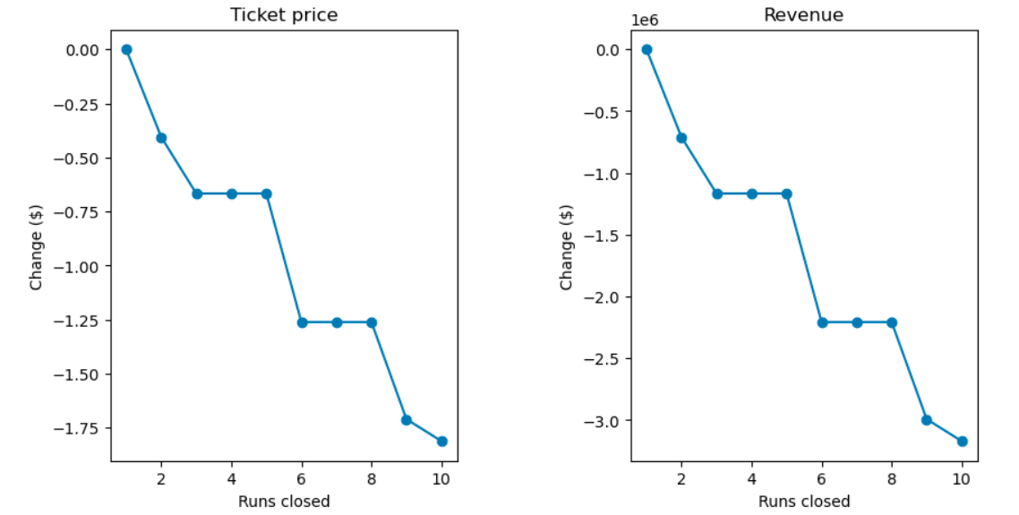
Alternatives Analyis
Examined four cost saving alternative scenarios:
Alternative 1: Closing up to 10 of the least used runs
Closing one run will not impact pricing.
Closing 2 runs will reduce revenue by 700,000 dollars
Closing 3 to 5 runs will reduce the revenue by $2,300,000.
Closing additional runs leads to a large drop in ticket prices and revenue.
Alternative 2: Increasing the vertical drop and installing an additional chair lift
Increase seasonal revenue $3,500,000.
Alternative 3: Increasing the vertical drop, constructing an additional chair lift, and adding an additional 2 acres of snow making cover
Same increase as Alternative 2
Alternative 4:Increasing the longest run by 0.2 miles
No Impact
Likely due to the limitations of the model

Slide 12
Recommendations
Results are impacted by the assumptions and limitations of the predictive model.
Competitor resorts are charging a fair market price
Ticket pricing is dependent on included resort facilities analyzed
Additional factors may impact the fair market value of the ticket.
Additional market research is recommended
Lower the uncertainty of the model
Increase understanding the ticket pricing model employed by competitor resorts
Support cost/beniftis analysis to determine facility construction/closure
Add additional amenities and their cost/usage/profitability
Include number of visitors of the resort and given facility
Include metrics of accessibility
Include operational costs of resort facilities

